Slide 1


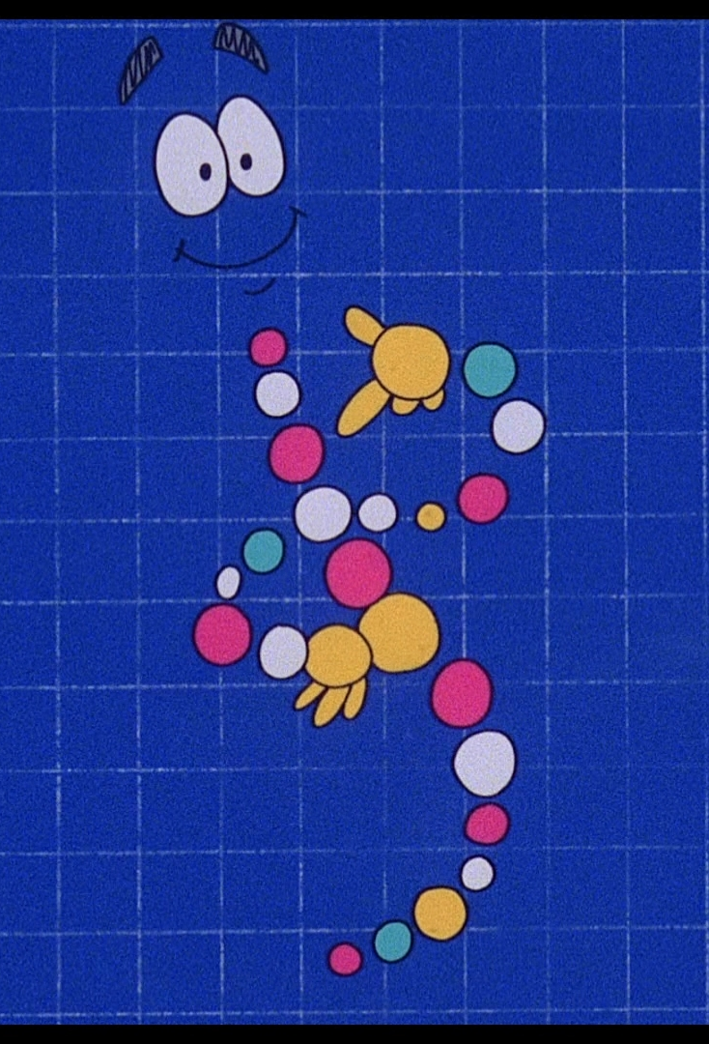

Slide 2




My genetics & brain tracking
Perform Smarter

Slide 3
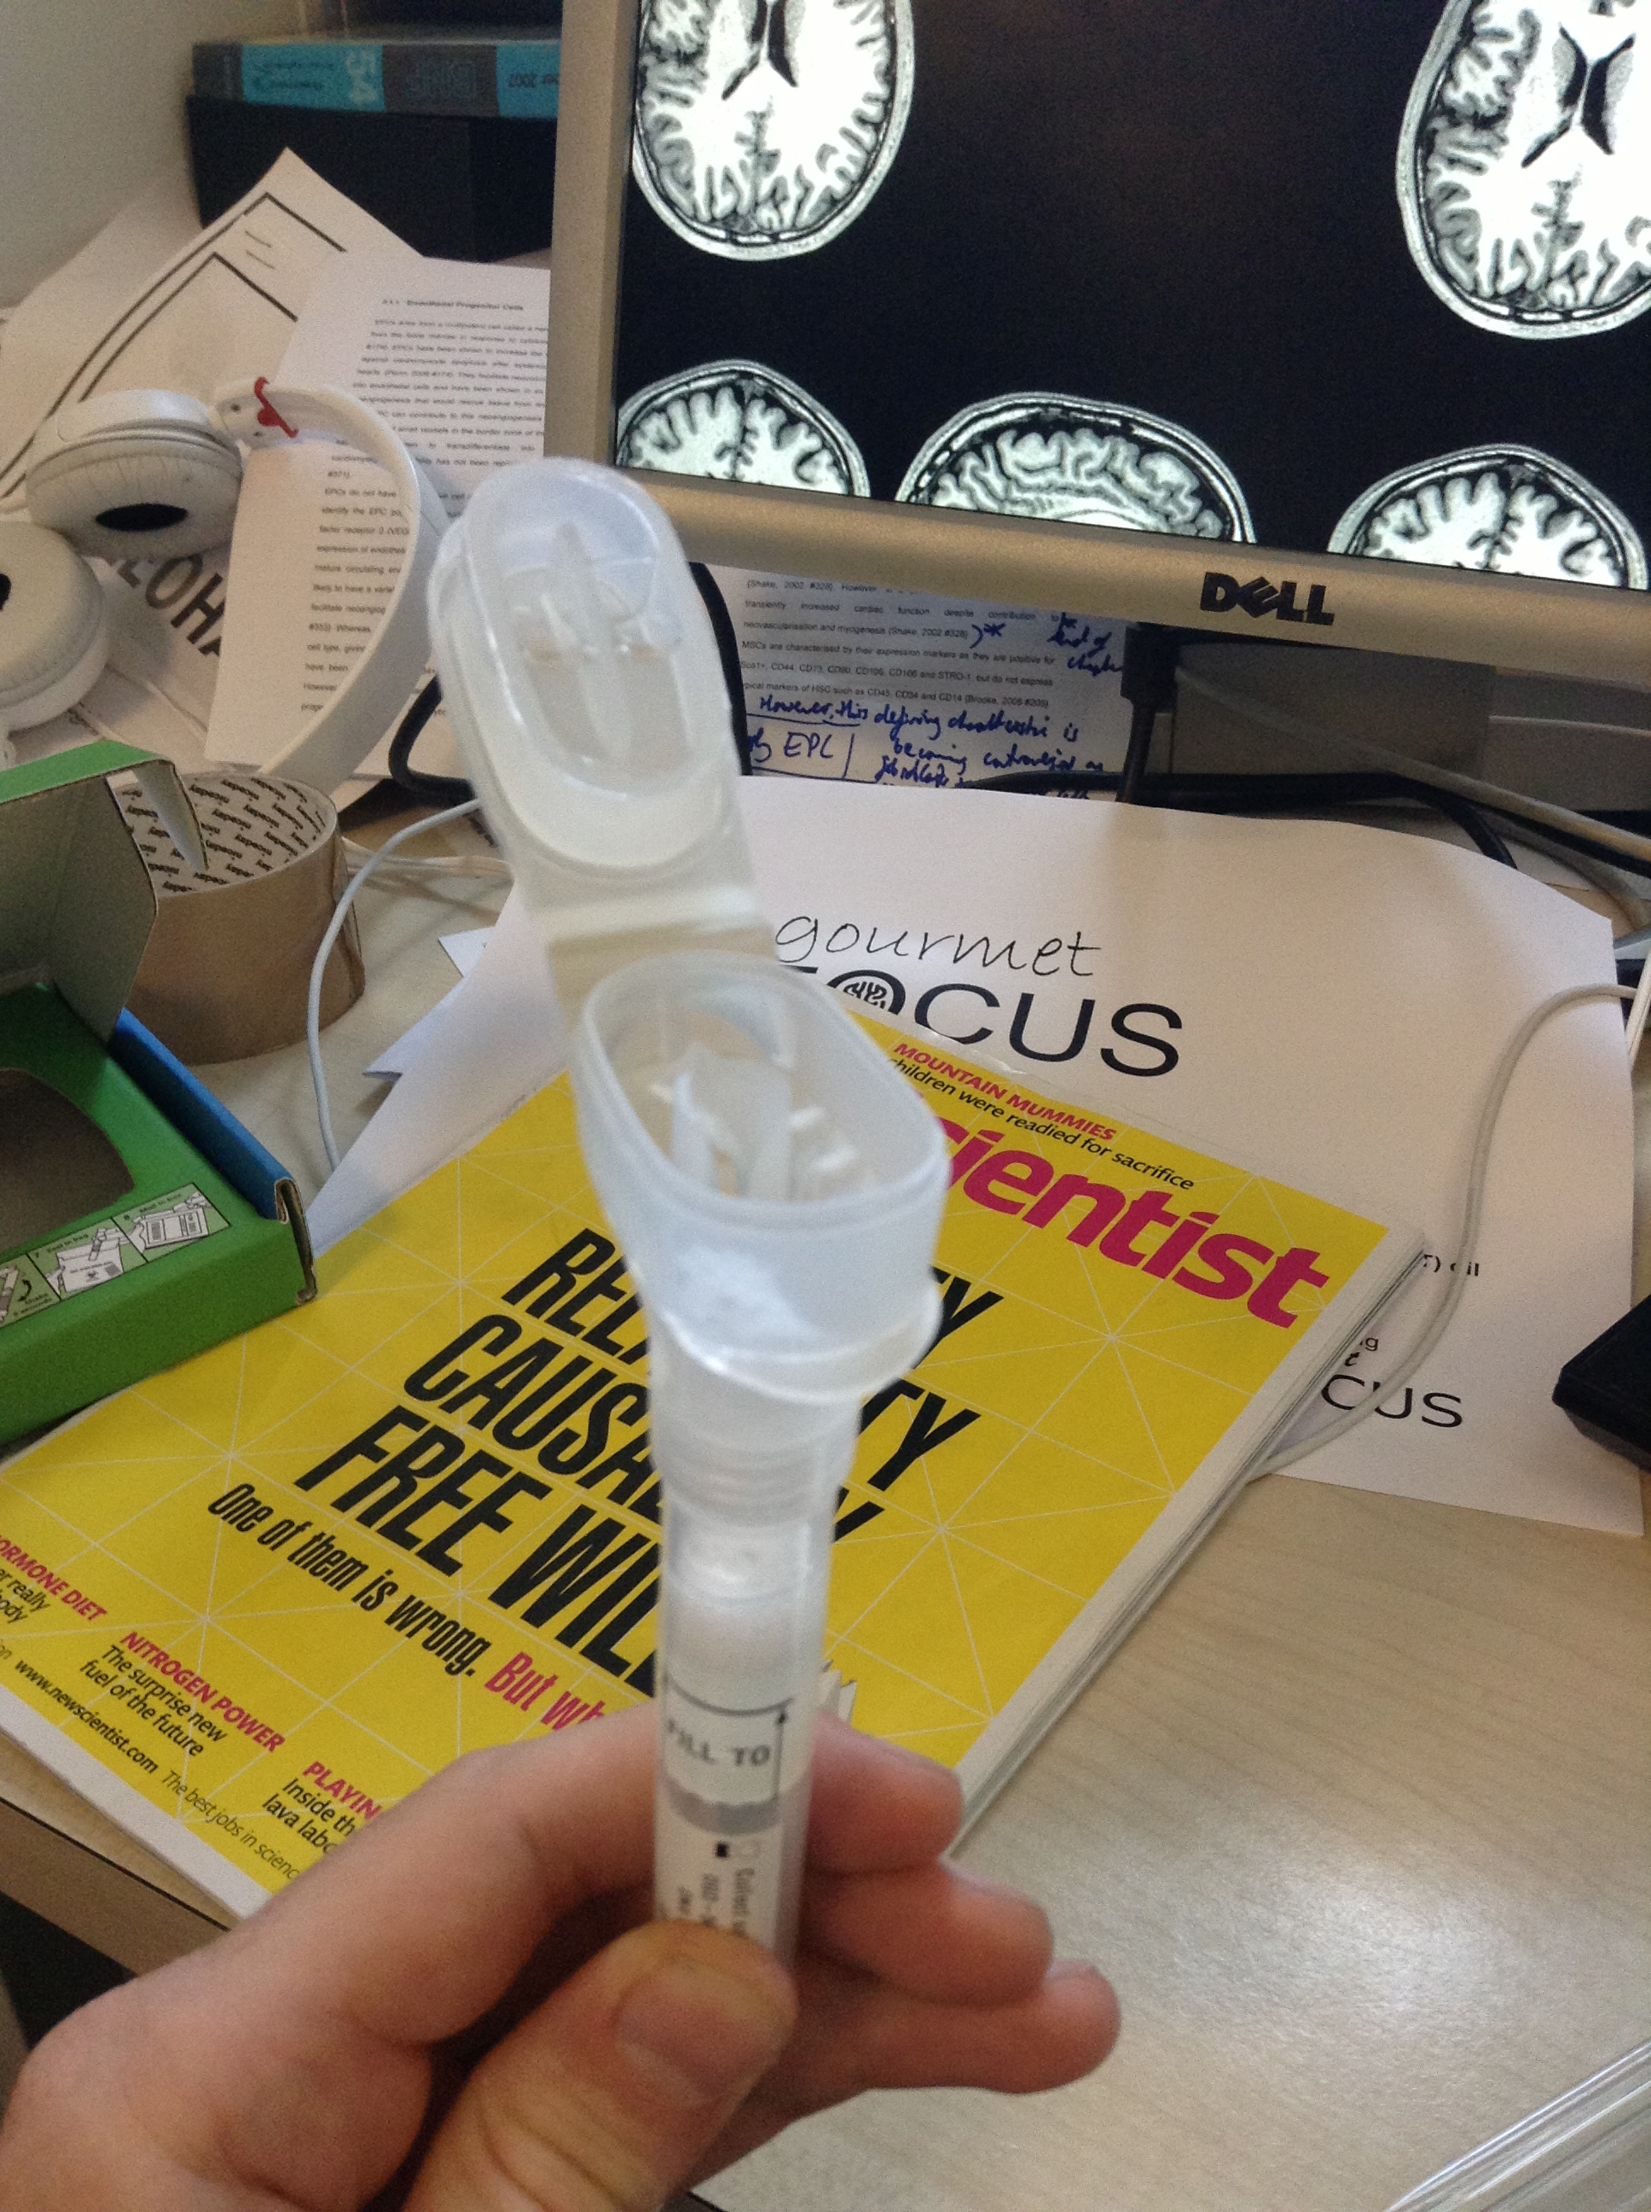
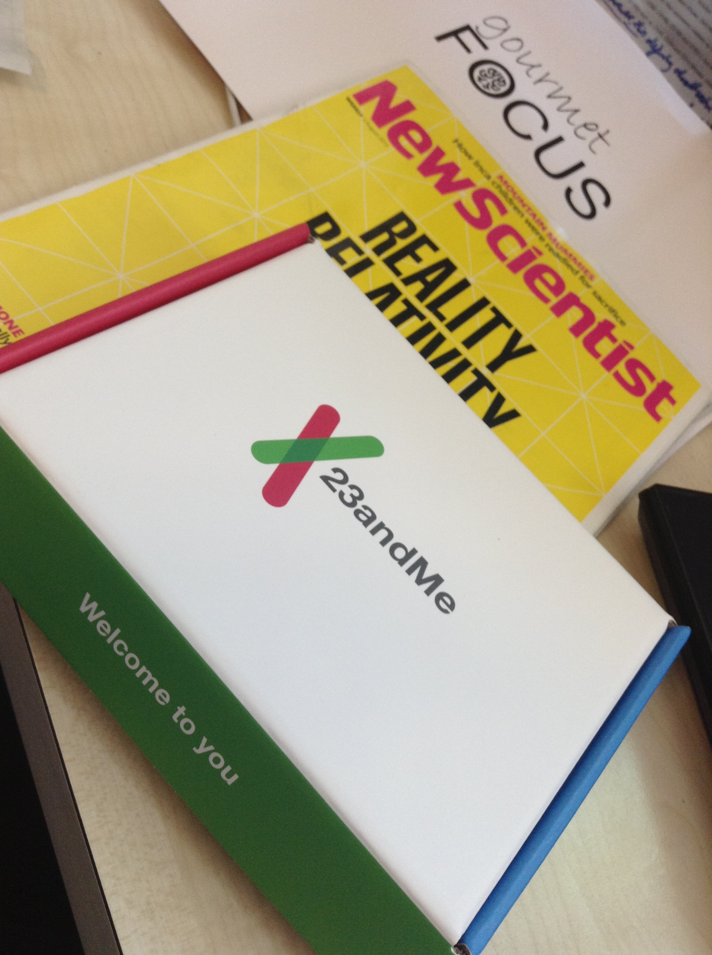
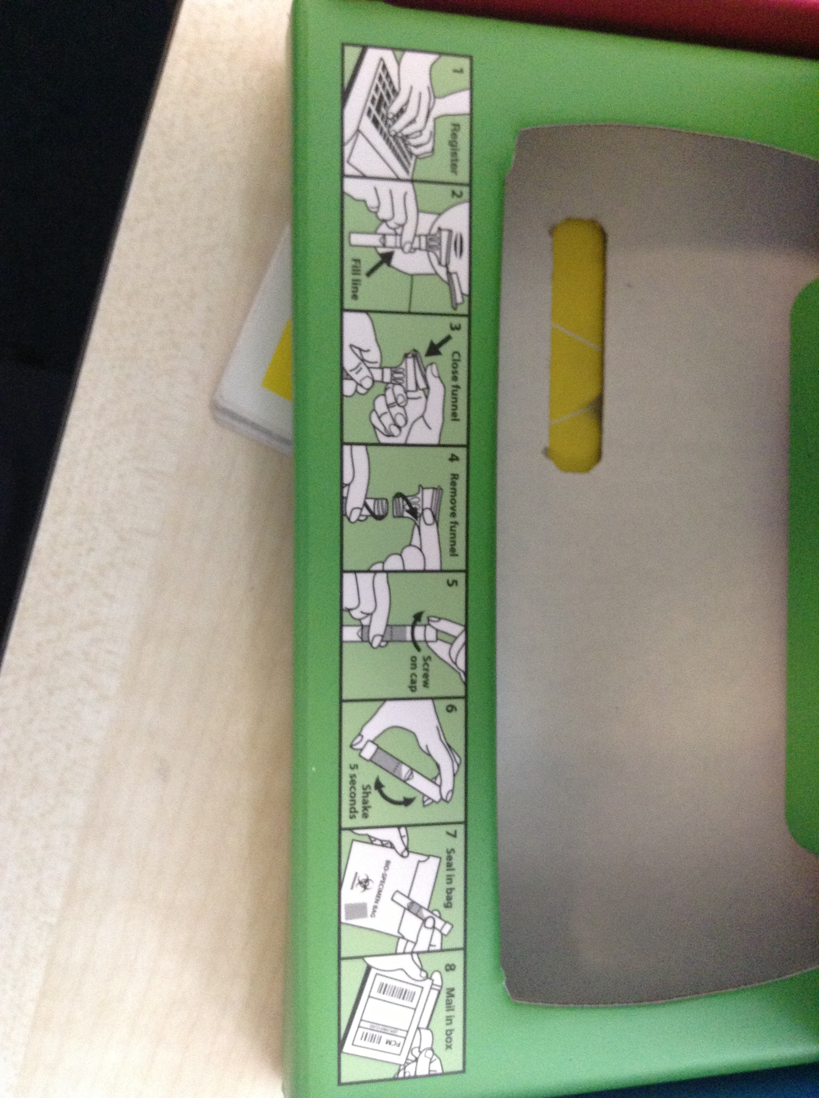
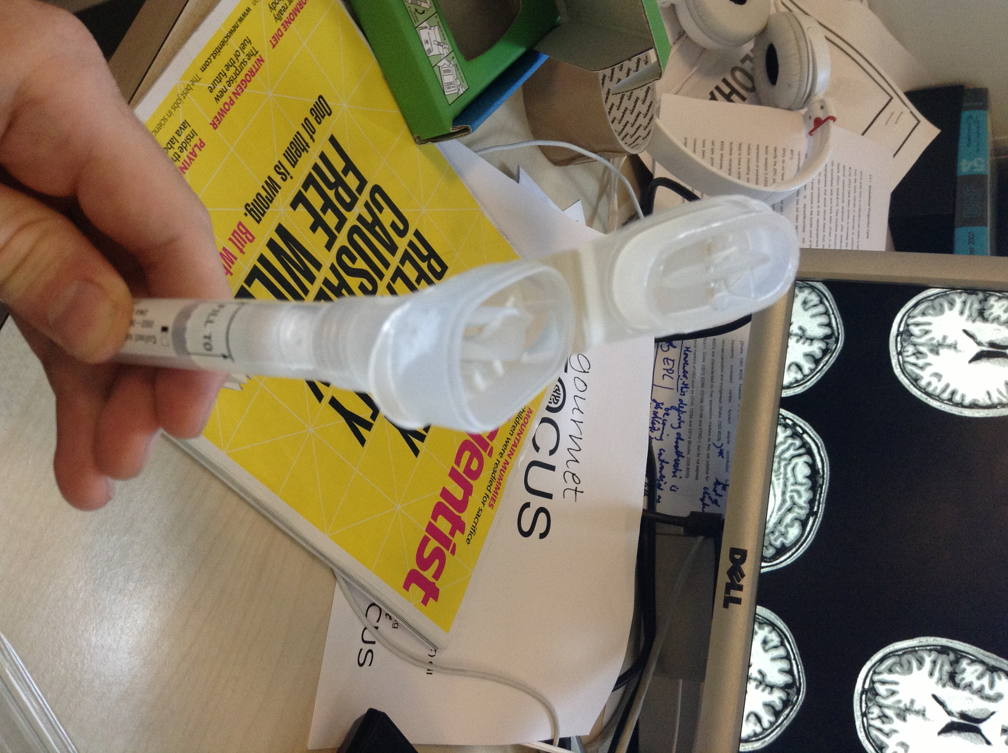
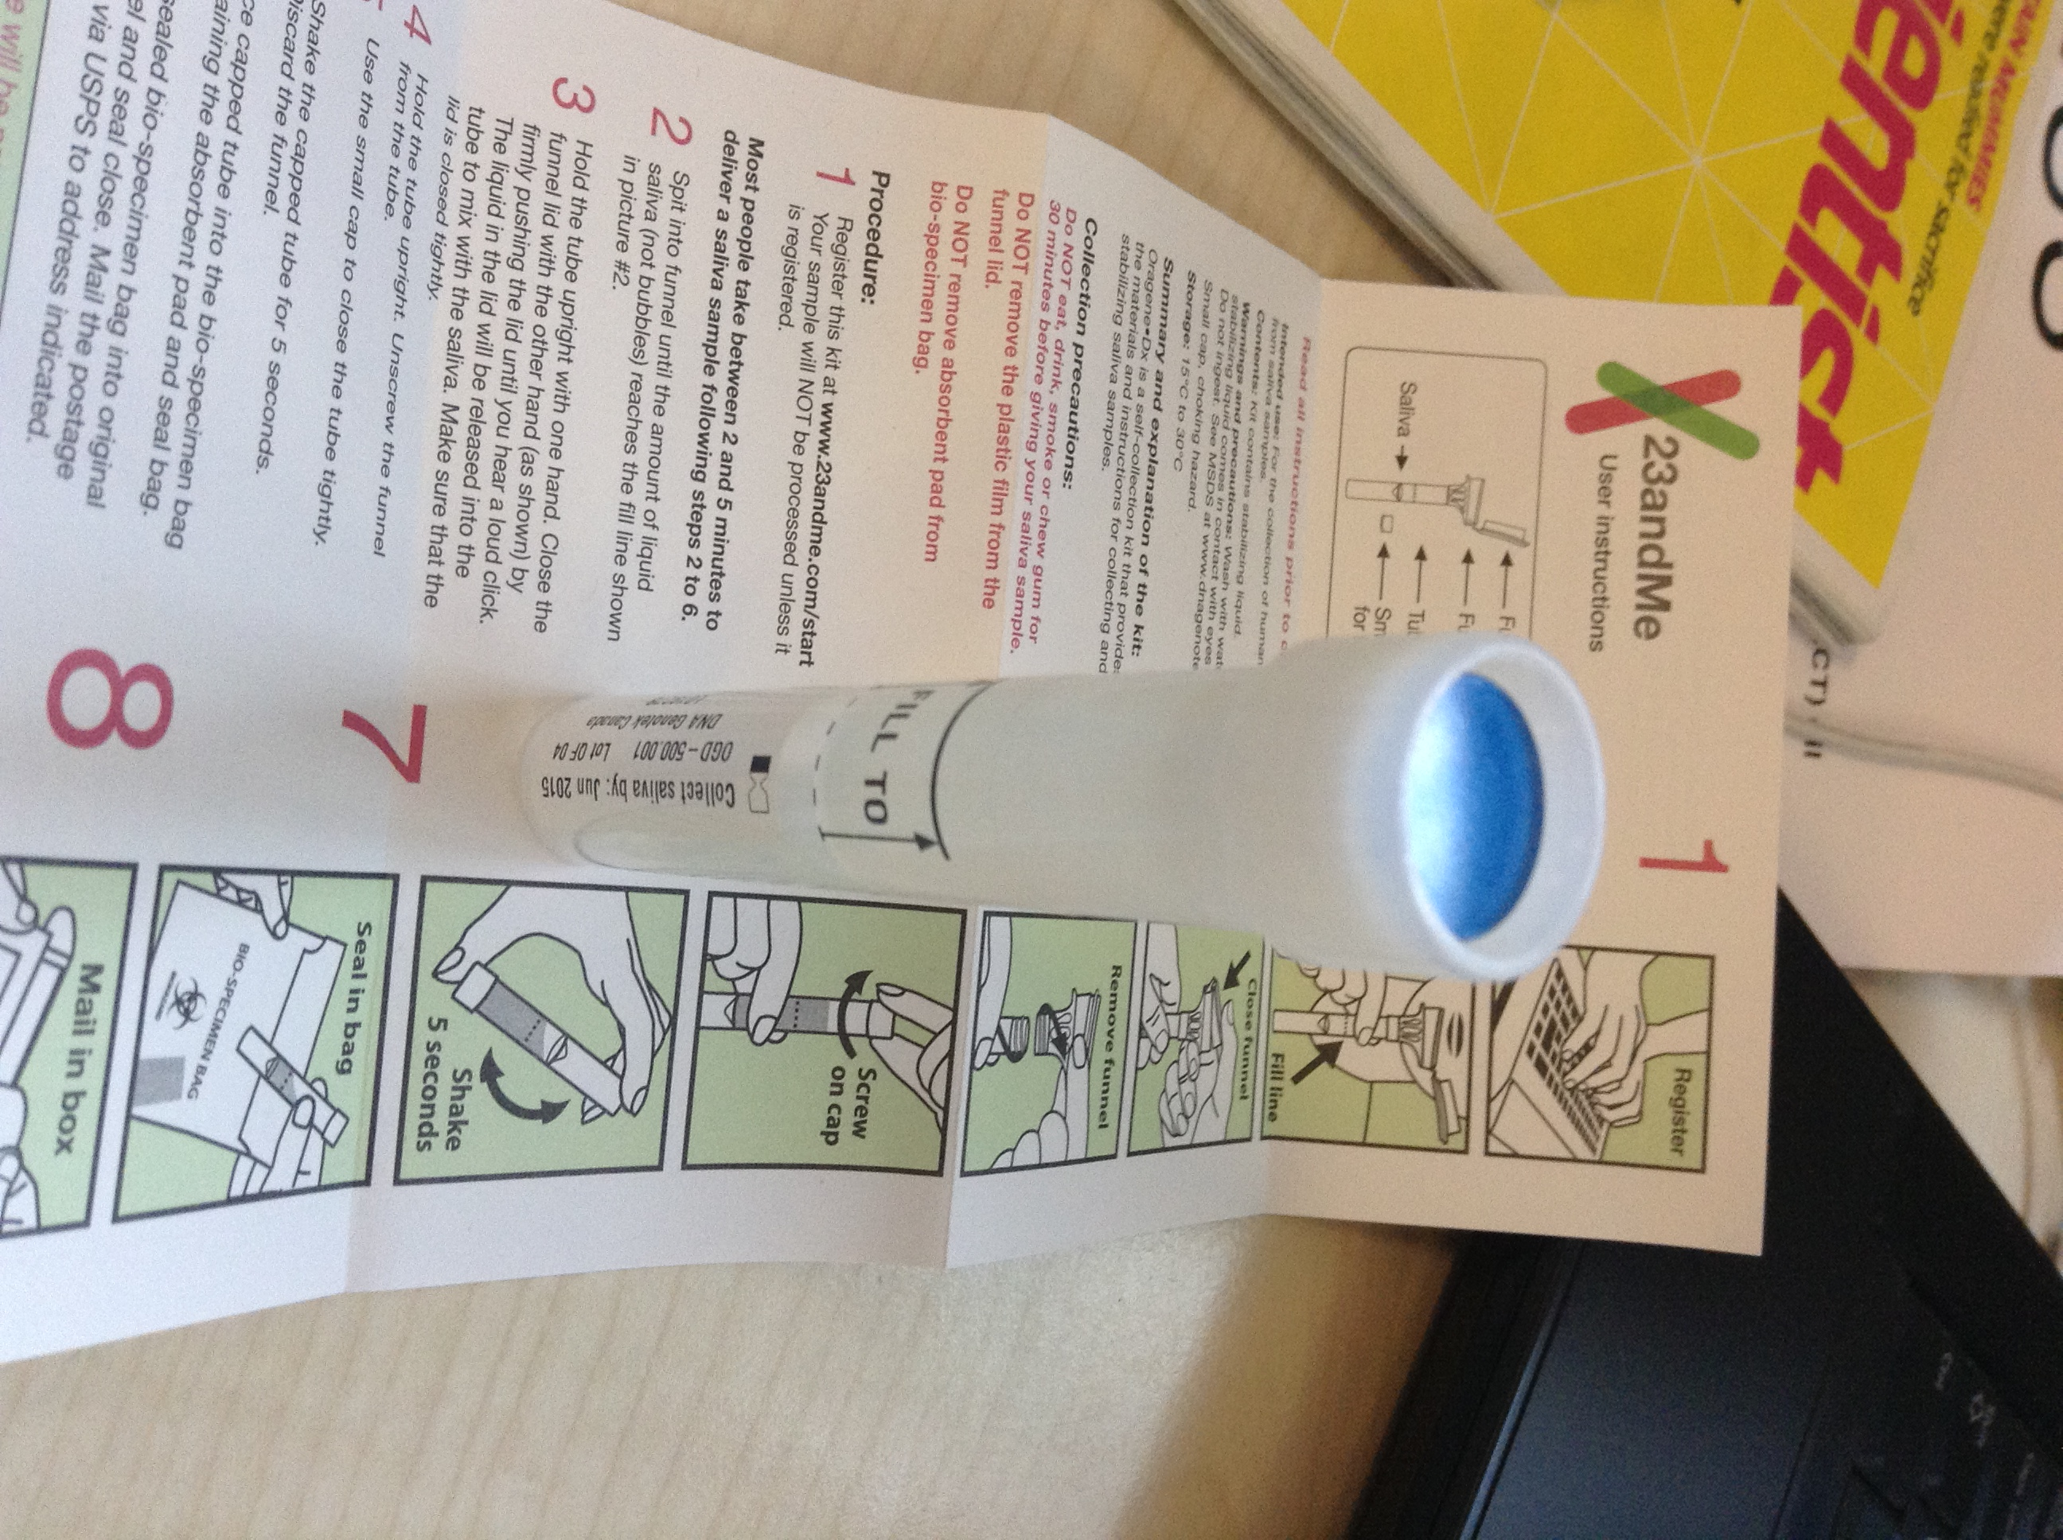
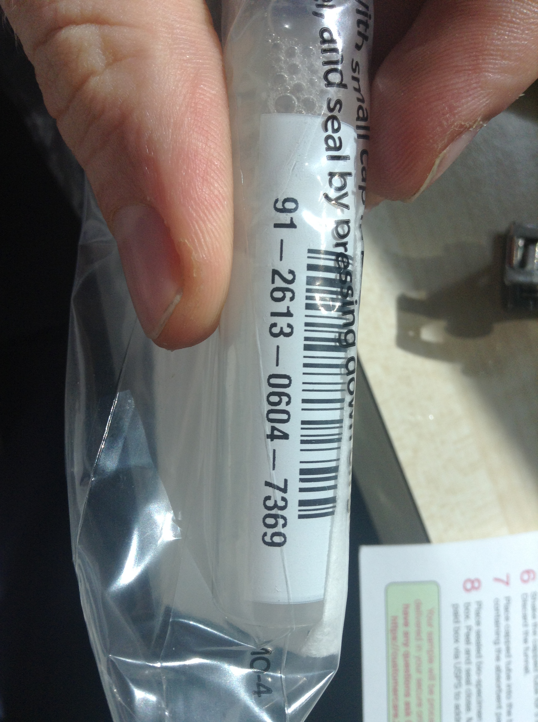
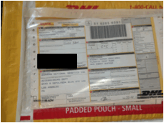

Slide 4

Within 3 weeks of ordering had my genome data
Split up between health and ancestry
Health is split up into
Health risks
Drug response
Inherited conditions
Traits
Ancestry is split up into
Parental line
Maternal line
Neanderthal ancestry

Slide 5
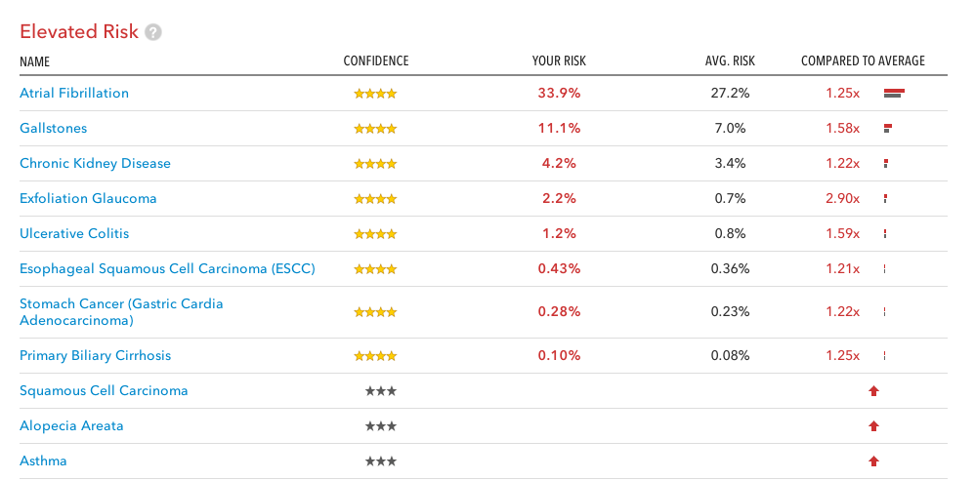

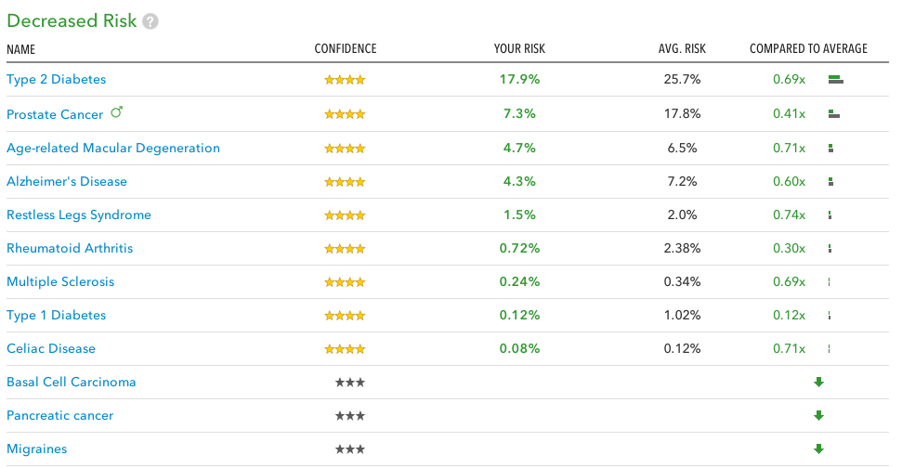
Parkinsons
Alzheimer’s

Slide 6
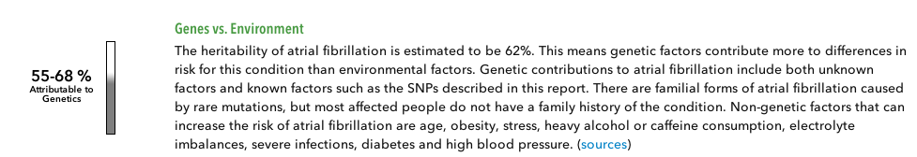
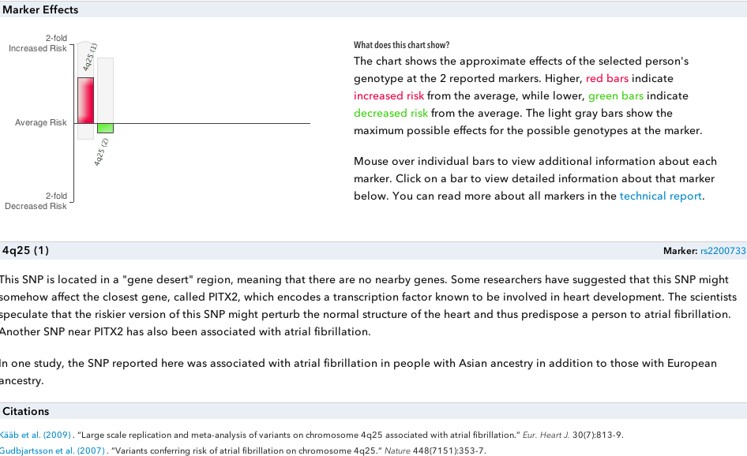

Slide 7
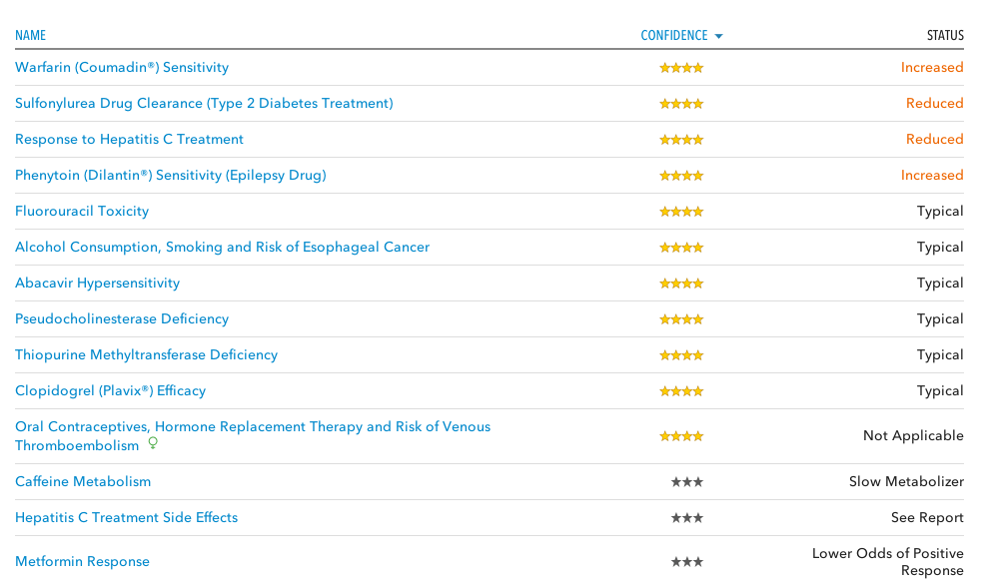
!!
Genotyping – All probability, it’s fixed and can’t change it
Can however change your environment

Slide 8

Bulletproof Coffee:
30g grass fed butter
10ml coconut/MCT oil
Short term memory, processing capability, reaction time
www.quantified-mind.com/experiment/gourmet_focus

Slide 9
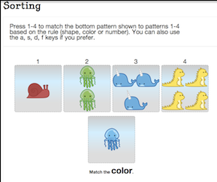
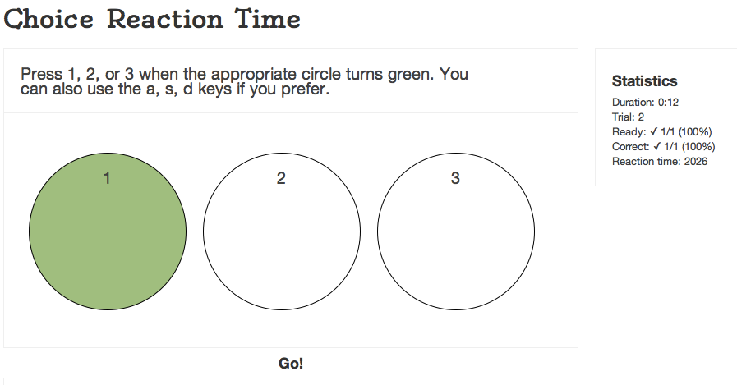
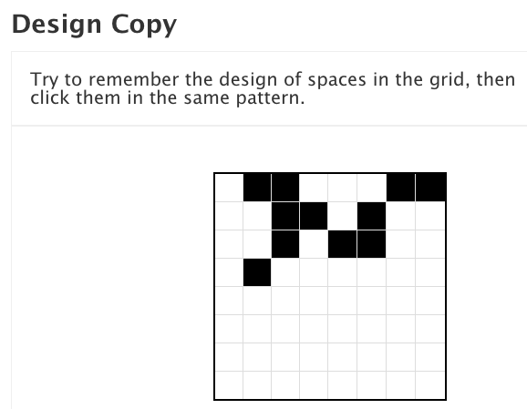
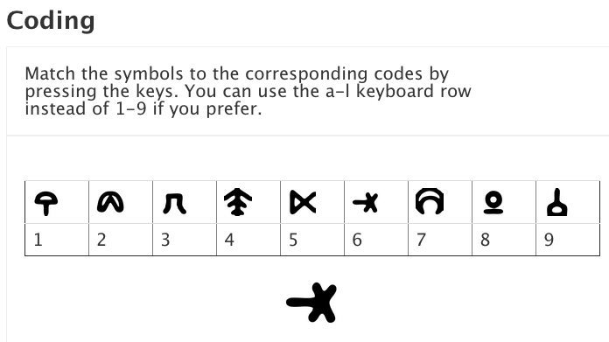

Slide 10
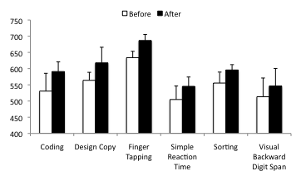
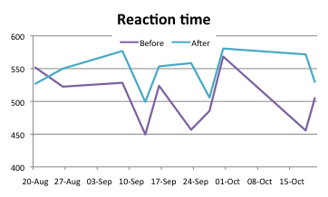
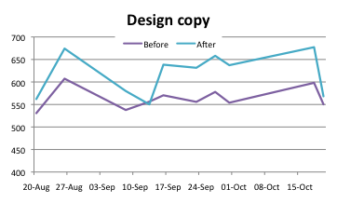
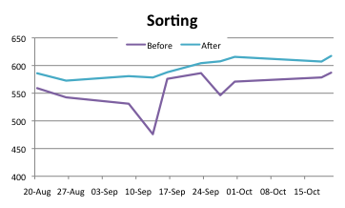
Results
*
*
*
*
*
* =p<0.05

Slide 11
Summary
DNA - 23andMe
- Increased risks & decreased risks
- Drug response
Brain performance tracking
- Quantified mind
- For ME Bulletproof coffee works ☺

Slide 12
#PerformSmarter
www.GourmetFocus.co.uk
@Gourmet_Focus
Owen@gourmetfocus.co.uk

